Slide 1

Tic tac toe
Rajankumar Mandanka
Marwadi University

Slide 2
Introduction
Game Name: Tic-Tac-Toe
Technology Stack: HTML, JavaScript
IDE: WebStorm
Key Points :-
Simple user friendly interface.
Two player game.
Game logic to determine win, loss, or draw.
Reset functionality for new games.

Slide 3
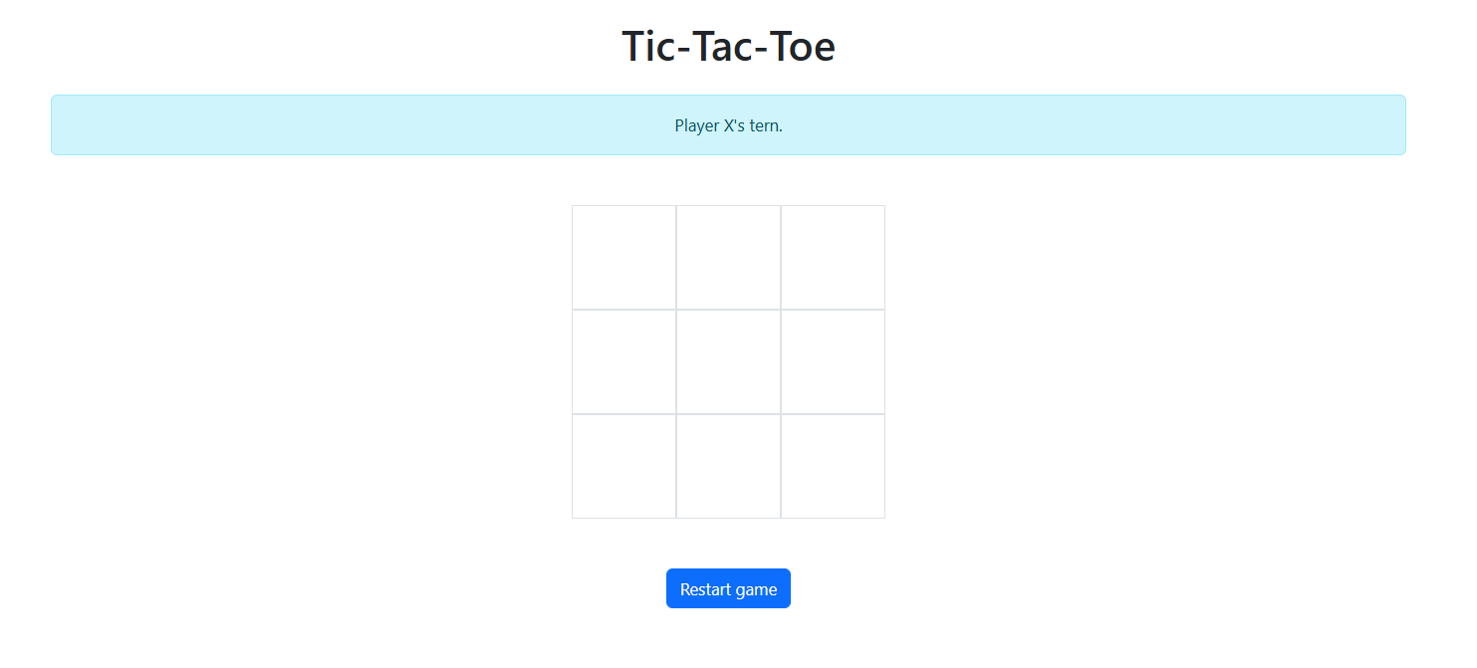
Interface

Slide 4
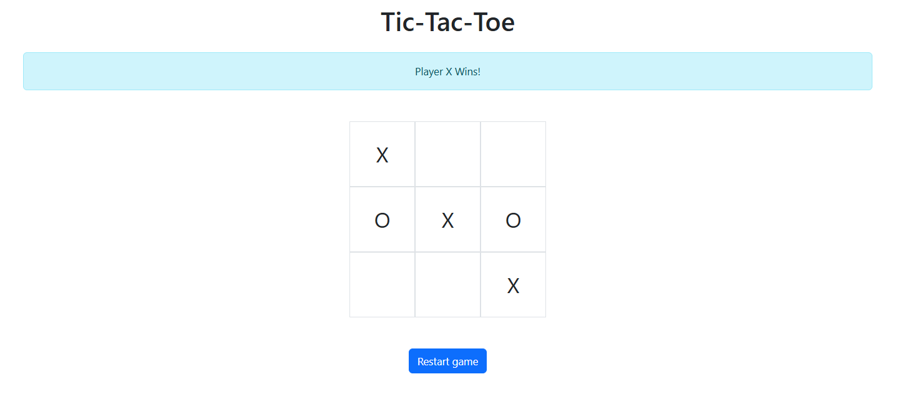
Player X Win

Slide 5
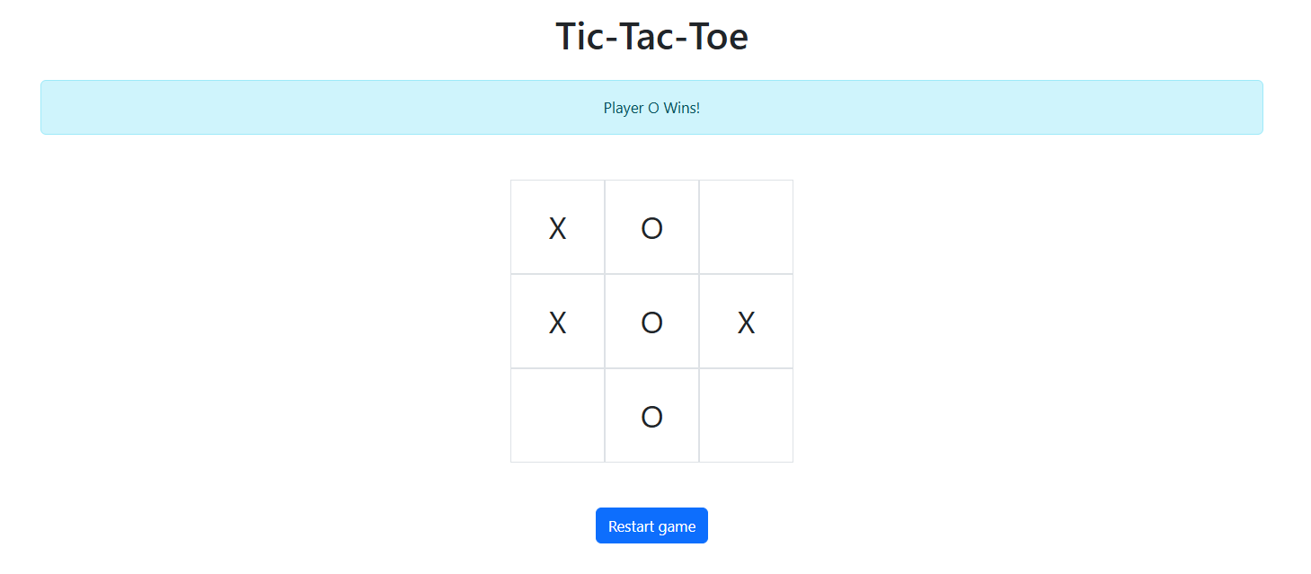
Player O WIn

Slide 6
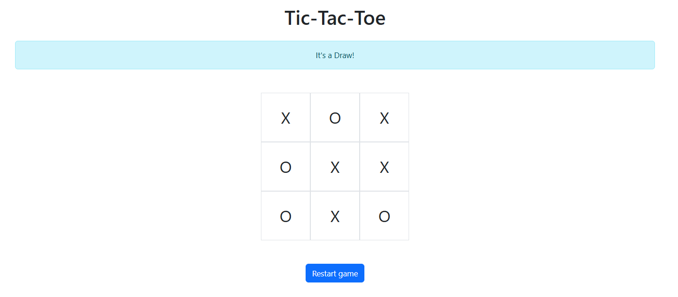
Game draw

Slide 7
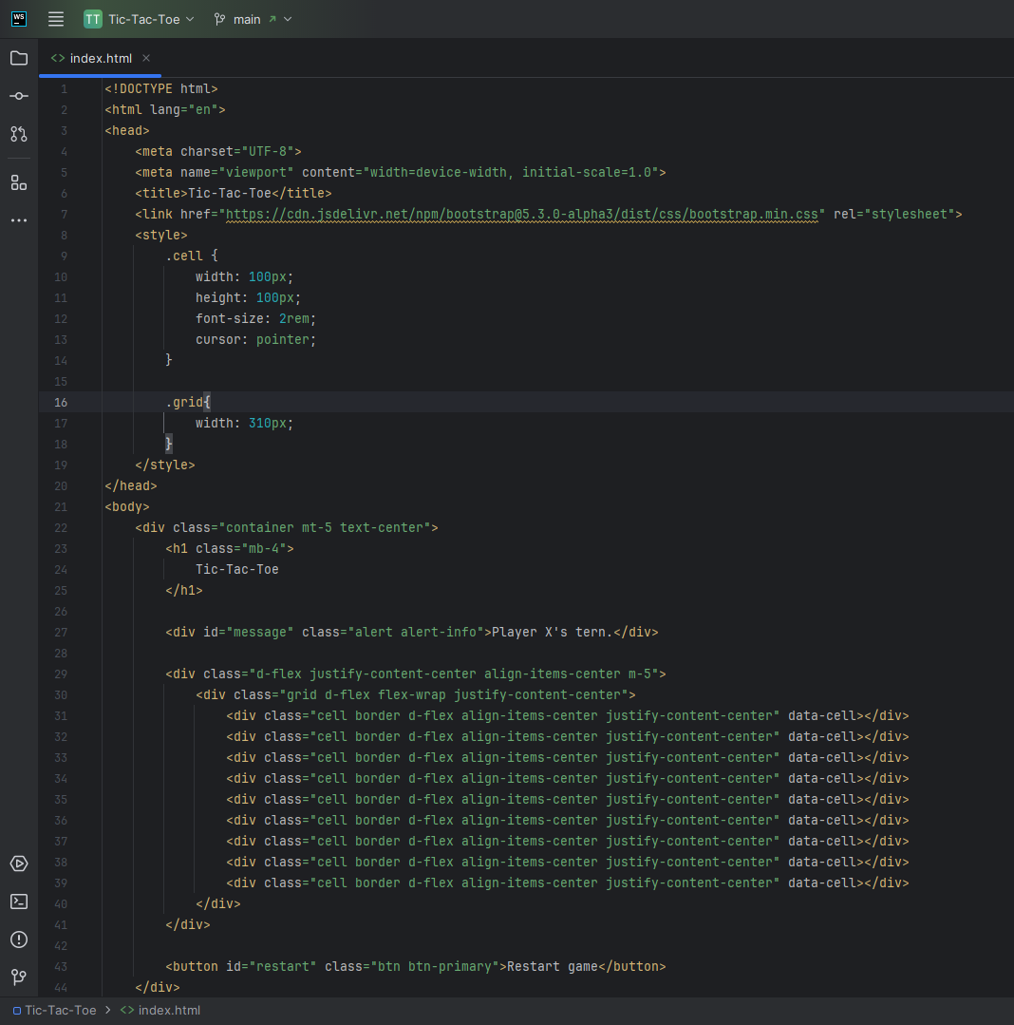
Index.html

Slide 8
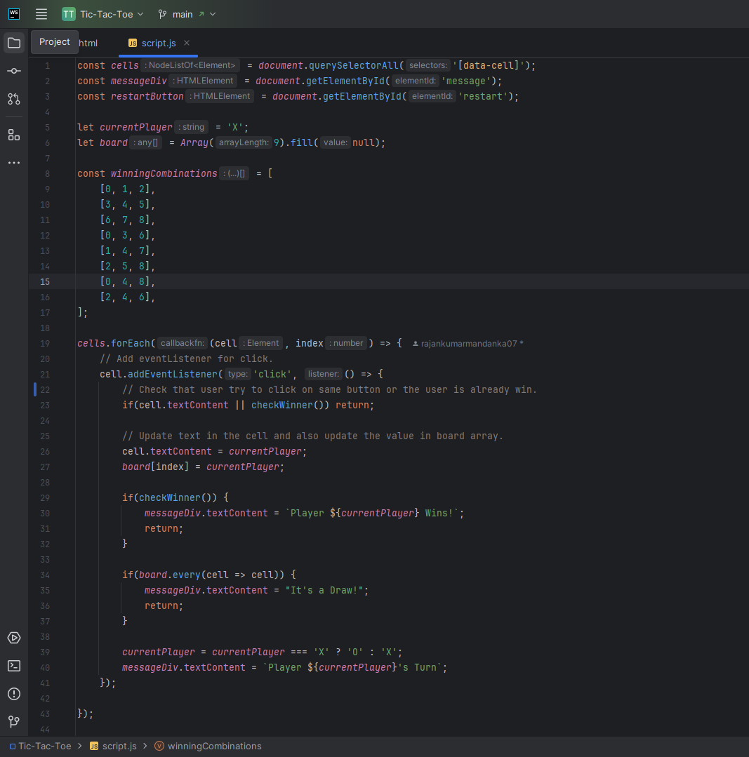
Script.js

